Slide 1
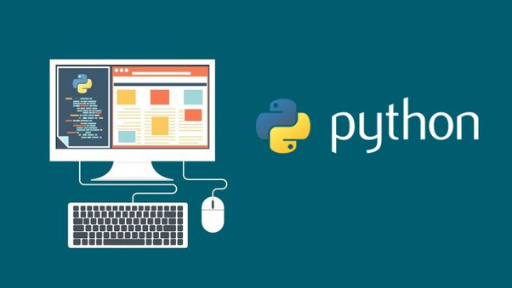
Week 9 Topics
Object Oriented Programming
Using the Debugger
Installing GIT Windows Desktop Client
Starting the Assignment with Pyspread
Interacting between Program Space and EXCEL

Slide 2
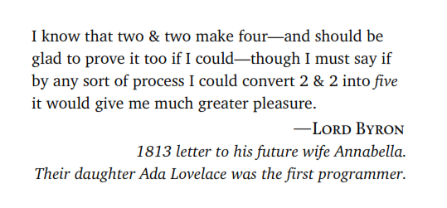

Slide 3
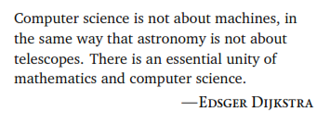
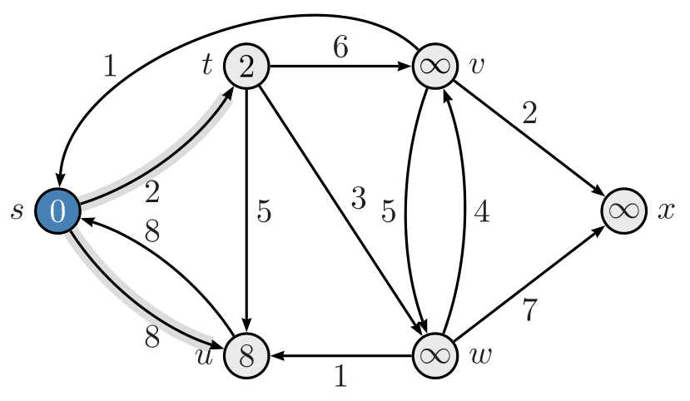

Slide 4
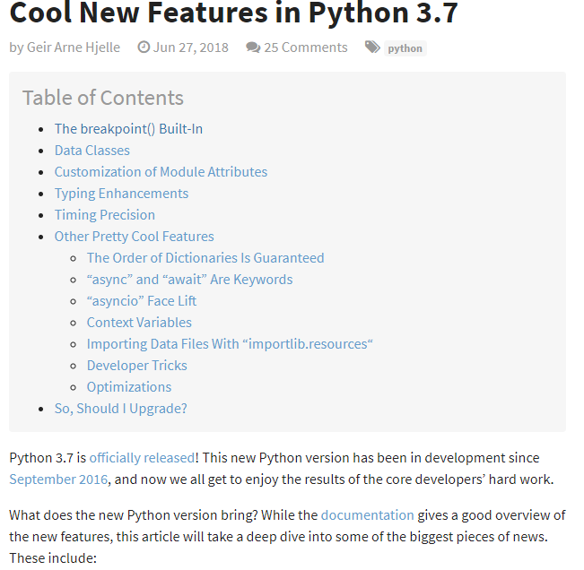
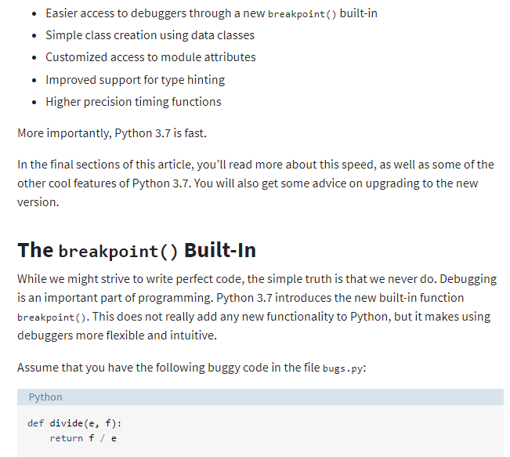

Slide 5
Python
No braces, no semicolons and very few parenthesis.
No need to explicitly specify a variable's type or the return value of a function.
Python doesn't support overloading
Using self allows you to re-use variable names. self is similar to ‘this’ in Java.

Slide 6
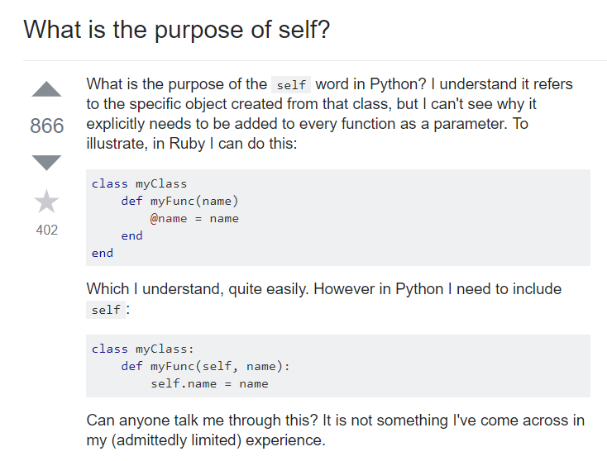
https://stackoverflow.com/questions/2709821/what-is-the-purpose-of-self

Slide 7
http://neopythonic.blogspot.com/2008/10/why-explicit-self-has-to-stay.html
Benefits of self in Python

Slide 8
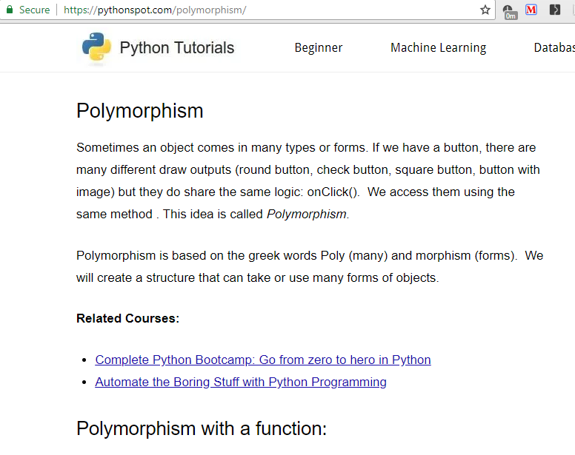
https://pythonspot.com/polymorphism/

